Slide 1

1. Features of a relational database

Slide 2

1
2
3
4
5
6
7
8
What is a Database?
A database is a collection of information that is organised
so that it can easily be accessed, managed, and updated.
In one view, databases can be classified according to types of content:
bibliographic, full-text, numeric, and images.

Slide 3
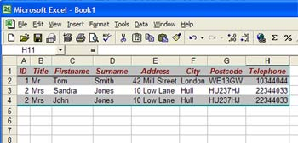
1
2
3
4
5
6
7
8
What is a flat file database?
A flat file database looks like this:
Advantages
All records are stored in one place
Easy to set up using a number of standard office applications
Easy to understand
Simple sorting of records can be carried out
Record can be viewed or extracted on the basis of simple criteria
Disadvantages
Potential duplication
Non-unique records
Harder to update
Inherently inefficient
Harder to change data format
Poor at complex queries
Poor at limiting access

Slide 4
1
2
3
4
5
6
7
8
What is a Relational Database?
A relational database is a collection of data items organised
as a set of formally-described tables from which data can be
accessed or reassembled in many different ways without having
to reorganise the database tables.

Slide 5
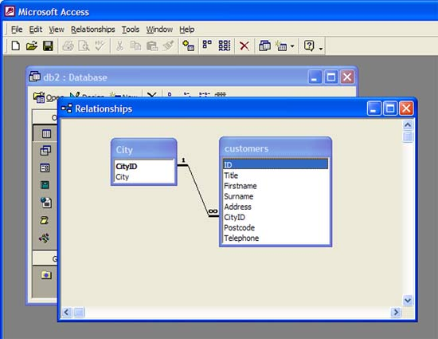
1
2
3
4
5
6
7
8
Relational Database?
To overcome the limitations of a simple flat file database that has only a single table,
another type of database has been developed called a 'relational database'.
A relational database holds its data over a number of tables instead of one.
Records within the tables are linked (related) to records held in other tables.

Slide 6
1
2
3
4
5
6
7
8
Task
What is an entity?
What is an ‘attribute’?
If you had a table called ‘patient, give me at least 4 example attributes
which would belong to this table
For each of the 4 example attributes, give me the data types which belong to each one
The field length and domain is trying to limit the content of the attribute so that it fits
In with the scenarios requirements. If you had attributes:
Date of Birth
First Name
Post Code
Gender
Mobile Number
For each, name their data type and the field length/domain restriction
e.g. landline – text, length 11 characters in the format ‘01656 765123’

Slide 7
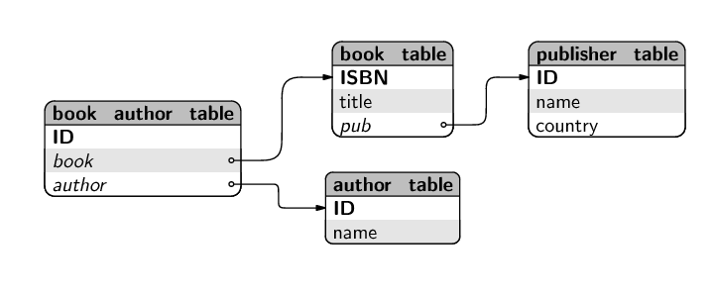
1
2
3
4
5
6
7
8
Relationships between entities
Two main types of relationship:
one-to-many (1:M)
e.g, book-publisher
A book has one publisher but a publisher may publish many books
many-to-many (M:M)
e.g, books-to-authors
A book may have many authors and an author may write many books

Slide 8
1
2
3
4
5
6
7
8
Referential Integrity
Integrity Rules
Entity Integrity | Description
Requirement | All Primary Key entries are unique
Purpose | Each row/record will have a unique identity and Foreign Key values can reference to Primary Key values.
Referential Integrity | Description
Requirement | A Foreign Key must have an entry that matches a Primary Key value in a table to which it is related.
Purpose | The enforcement of Referential Integrity means that it is impossible to delete a row/record that links to Key values in other tables. This would cause ‘orphan’ records.

Slide 9
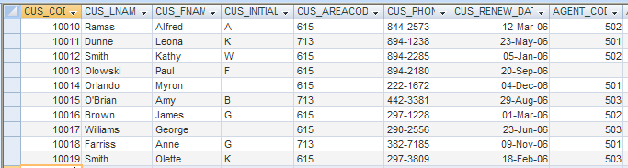
1
2
3
4
5
6
7
8
Orphaned records
In this case, customer number 10013 is an orphaned record because there is not a value in the Agent_Code Foreign Key field linking the record to a corresponding Primary Key in the sales agent table.

Slide 10
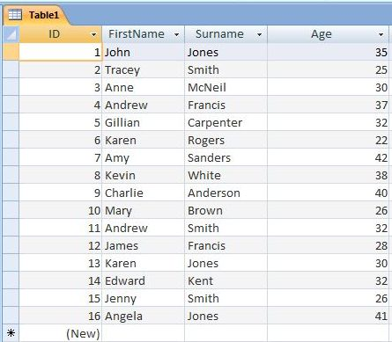
1
2
3
4
5
6
7
8
Database Terms
Database
Collection of tables containing related information
Tables
2-dimensional array
columns called "fields"
rows called "records"
Primary key
Uniquely identifies each record
Examples:
StudentID, CustID, OrderID, ISBN...
So:
if you know the value of a record’s PK,
e.g ID 9 in this table, then you can call up this record
from the ID and read off other information about this student
Also, the other fields are functionally dependant on the PK.
In this table, all of the fields are functionally dependant on the PK.

Slide 11

1
2
3
4
5
6
7
8
Normalisation
Database Normalization
Process of organising data into tables & relationships
Goal:
Eliminate data redundancy
Maintain data integrity
All attributes in a table are dependent on its Primary Key (PK)

Slide 12
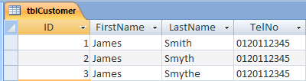
1
2
3
4
5
6
7
8
Data Redundancy
This database would be useless as it would not match records
where the last name should be Smith due to the data inconsistency.
Data Redundancy
The same data is stored unnecessarily in different places.
Leads to:
Data inconsistency due to multiple input errors

Slide 13
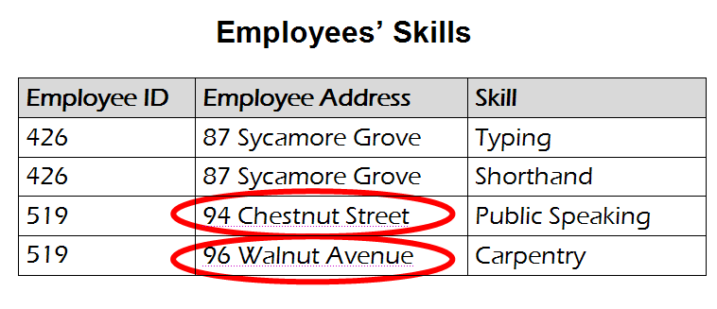
1
2
3
4
5
6
7
8
Data Integrity 1
An improperly normalised database may have any of the following problems.
The same information could be on multiple rows;
therefore updates to the table may result in logical inconsistencies.
For example, each record in an "Employees' Skills"
table might contain an Employee ID, Employee Address, and Skill;
thus a change of address for a particular employee
will potentially need to be applied to multiple records
(one for each of his skills). If the update is not carried through
successfully—if, that is, the employee's address is updated
on some records but not others—then the table is left in an
inconsistent state. Specifically, the table provides
conflicting answers to the question of what this particular employee's address is.
This phenomenon is known as an update anomaly.
Update Anomaly

Slide 14
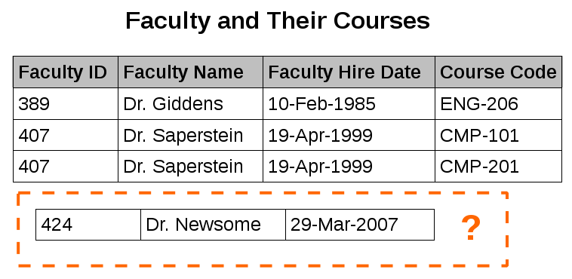
1
2
3
4
5
6
7
8
Data Integrity 2
An improperly normalised database may have any of the following problems.
There are circumstances in which certain facts cannot be
recorded at all because of the incorrect table structure.
For example, each record in a "Faculty and Their Courses"
table might contain a Faculty ID, Faculty Name, Faculty Hire Date,
and Course Code—thus we can record the details of any faculty
member who teaches at least one course, but we cannot record
the details of a newly-hired faculty member who has not yet been
assigned to teach any courses except by setting the Course Code to null.
This phenomenon is known as an insertion anomaly.

Slide 15
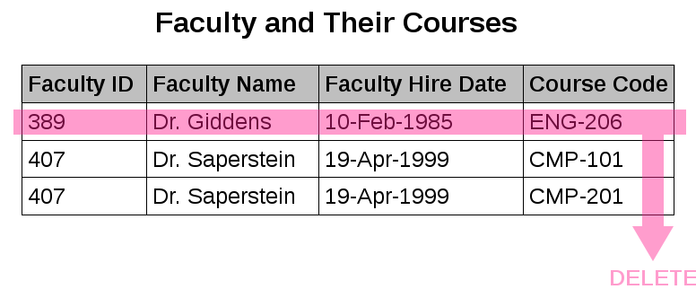
1
2
3
4
5
6
7
8
Data Integrity 3
An improperly normalised database may have any of the following problems.
In a table that has not been normalised there may be circumstances
in which the deletion of data representing certain facts causes the
deletion of data representing completely different facts.
The "Faculty and Their Courses" table described in the
previous example suffers from this type of anomaly,
for if a faculty member temporarily ceases to be assigned
to any courses, we must delete the last of the records on
which that faculty member appears, effectively also
deleting the faculty member.
This phenomenon is known as a deletion anomaly.

Slide 16
1
2
3
4
5
6
7
8
Rules of Normalisation
Normal Form | Characteristic
First normal form (1NF) | Fields should be atomic, no repeating groups and a PK (Primary Key) should have been identified.
Second normal form (2NF) | The table should be in 1NF with no partial dependencies.
Third normal form (3NF) | The table should be in 2NF with no transitive dependencies.
Once a database is properly normalised the tables will have the following characteristics:
Each table will represent a single entity,
No data item will be stored unnecessarily in more than one table,
All attributes (fields) in the table will be functionally dependant on the primary key –
the entire primary key and nothing but the primary key!

Slide 17

1
2
3
4
5
6
7
8
First Normal Form or 1NF – slide 1
Student_ID | Name | Initial | Date_of_birth | Subject | Grade
960100 | Smith | J | 14/11/1977 | Databases | C
960100 | Smith | J | 14/11/1977 | Soft_Dev | A
960100 | Smith | J | 14/11/1977 | ISDE | D
960105 | White | A | 10/05/1975 | Soft_Dev | B
960105 | White | A | 10/05/1975 | ISDE | B
960120 | Moore | T | 11/03/1970 | Databases | A
960120 | Moore | T | 11/03/1970 | Soft_Dev | B
960120 | Moore | T | 11/03/1970 | Workshop | C
960145 | Smith | J | 09/01/1972 | Databases | B
960150 | Black | D | 21/08/1973 | Databases | B
960150 | Black | D | 21/08/1973 | Soft_Dev | D
960150 | Black | D | 21/08/1973 | ISDE | C
960150 | Black | D | 21/08/1973 | Workshop | B
Warning – this table
is not in 1NF
This table looks fine but… …
It has repeating groups – the subject and grades are repeating groups.
This means that the Student_ID is not working properly as a Primary Key (PK) because it does not uniquely identify each record.
A Composite PK needs to be devised so that the composite PK will uniquely identify each record.

Slide 18

1
2
3
4
5
6
7
8
First Normal Form or 1NF – slide 1
Identify the Primary Key
Using Standard Notation, it is possible to see how a Composite Primary Key made up of Student_ID and Subject can represent unique values for each record.
STUDENT(Student_ID, Name, Initial, Date_of_Birth, Subject, Grade)
Student_ID | Name | Initial | Date_of_birth | Subject | Grade
960100 | Smith | J | 14/11/1977 | Databases | C
960100 | Smith | J | 14/11/1977 | Soft_Dev | A
960100 | Smith | J | 14/11/1977 | ISDE | D
960105 | White | A | 10/05/1975 | Soft_Dev | B
960105 | White | A | 10/05/1975 | ISDE | B
960120 | Moore | T | 11/03/1970 | Databases | A
960120 | Moore | T | 11/03/1970 | Soft_Dev | B
960120 | Moore | T | 11/03/1970 | Workshop | C
960145 | Smith | J | 09/01/1972 | Databases | B
960150 | Black | D | 21/08/1973 | Databases | B
960150 | Black | D | 21/08/1973 | Soft_Dev | D
960150 | Black | D | 21/08/1973 | ISDE | C
960150 | Black | D | 21/08/1973 | Workshop | B
Although this table is in 1NF there is (a) data duplication and (b) Name and DateOfBirth are partial dependencies because they do not depend on Subject!

Slide 19
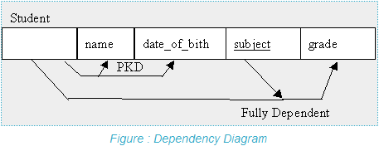
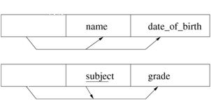
1
2
3
4
5
6
7
8
Second Normal Form or 2NF
Student_ID | Name | Initial | Date_of_birth | Subject | Grade
960100 | Smith | J | 14/11/1977 | Databases | C
960100 | Smith | J | 14/11/1977 | Soft_Dev | A
960100 | Smith | J | 14/11/1977 | ISDE | D
Student_ID
This table is not in 2NF
The solution is to split the table into its component parts:
separate out all the attributes that are solely dependent on Student_ID,
put them in a new STUDENT table, with Student_ID as the primary key,
separate out all the attributes that are solely dependent on subject,
in this case no attributes are solely dependent on subject,
separate out all the attributes that are solely dependent on Student_ID and Subject
put them into a separate STUDENTGRADE table with Student_ID and Subject as a Composite Primary Key.
STUDENT
Student_ID
STUDENTGRADE
Student_ID

Slide 20
1
2
3
4
5
6
7
8
Second Normal Form or 2NF
STUDENT
Student_ID | Name | Initial | DateOfBirth
960100 | Smith | J | 14/11/1977
960105 | White | A | 10/05/1975
960120 | Moore | T | 11/03/1970
960145 | Smith | J | 09/01/1972
960150 | Black | D | 21/08/1973
Student_ID
STUDENTGRADE
Student_ID
Student_ID | Subject | Grade
960100 | Databases | C
960100 | Soft_Dev | A
960100 | ISDE | D
960105 | ISDE | B
… | … | …
960150 | Workshop | B
This table is now in 2NF
There is no longer an insertion anomaly
It is now possible to enter new students without knowing the subjects that they will be studying
They will exist only in the Student table, and will not be entered in the Record table until they are studying at least one subject.
The deletion anomaly is also removed
If all of the `databases' subject records are removed, student 960145 still exists in the Student table.
We have also removed the update anomaly

Slide 21
1
2
3
4
5
6
7
8
Third Normal Form or 3NF
In 3NF, the database designer just checks every table to see if all fields are each wholly dependent on the PK
The rule for 3NF
A relation is in 3NF if, and only if, it is in 2NF and there are no transitive functional dependencies.

Slide 22
1
2
3
4
5
6
7
8
Third Normal Form or 3NF
Here is a new example of a database recording company projects and project managers:
Project_ID | Manager | Initial | Address
1 | Black | B | 32 High Street
2 | Smith | J | 11 New Street
3 | Black | B | 32 High Street
4 | Bond | J | 07 Chapel Street
Check each field to see if it is functionally and wholly dependant on the PK.
Or:
when there is more than one field in a table, check to see if there are any fields that have transitive dependency.
Transitive dependency is when one of the fields in a table does not wholly depend on the PK but does depend on one of the other fields.
In this table, the Address field does not depend on the PK.
It does depend on the Manager field so it has a transitive dependency on a non-key field.
So: split up the tables.
Project_ID | Manager | Initial
1 | Black | B
2 | Smith | J
3 | Black | B
4 | Bond | J
Manager_ID | Initial | Address
Black | B | 32 High Street
Smith | J | 11 New Street
Bond | J | 07 Chapel Street

Slide 23
1
2
3
4
5
6
7
8
Third Normal Form or 3NF
Project_ID | Manager | Initial
1 | Black | B
2 | Smith | J
3 | Black | B
4 | Bond | J
Manager_ID | Initial | Address
Black | B | 32 High Street
Smith | J | 11 New Street
Bond | J | 07 Chapel Street
These tables are now in 3NF
the address is stored only once ,
if we need to know a manager's address we can look it up in the Manager table,
the manager attribute is the link between the two tables, and in the Projects table it is now a foreign key.

